Slide 1
November 2022 Hazardous Materials
Roundtable Meeting Report
Eddie Murphy

Slide 2

Discussion Items
Reviewed 2021 Roundtable
Summarized actions and work being done by Roundtable Members and Federal Partners
Discussed Emergent Issues
Listed Next Steps

Slide 3
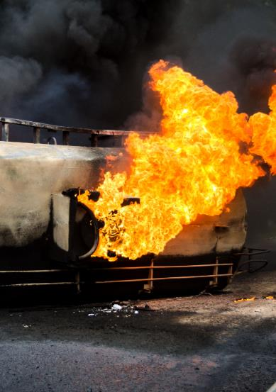
Review of the 2019-2021 Roundtable Meetings
2019-2021 HazMat Roundtable
Emergent Issues and Actions Needed
Planning
Prevention
Response
Training
Standard of Care
Funding
Information
Sharing
Pre-Roundtable 2021 Feasibility Studies
Improve LEPC/TERC Performance
Improve Risk-Based Preparedness/Response
Improve Hazmat Prevention/Mitigation
Problem Analysis
Proposed Action Options
Notes:
We reviewed the action recommendations of the 2019 Roundtable, of the 2021 Pre-Roundtable Feasibility Studies, and of the 2021 Roundtable meeting. These recommendations all were intended to address seven areas of national need that had been identified to improve national hazmat emergency preparedness. The seven areas of action recommendations are:
Actions to Improve Hazmat Planning and LEPC/TERC Performance
Actions to Improve Risk-Based Preparedness and Response
Actions to Improve Hazmat Prevention/Mitigation
Actions to Improve Hazmat Training
Actions to Improve Hazmat Standard of Care
Actions to Improve Hazmat Funding
Actions to Improve Hazmat Information Sharing

Slide 4
Summary of Work being done following the 2021 Roundtable
Notes:
After reviewing the needs and action recommendations made in the 2019 and 2021 Roundtable meetings, attendees at this virtual Roundtable presented overviews of ongoing work in their respective organizations to help address national needs. Agencies participating in the meeting included EPA, SOL/OSHA, FEMA, USFA/FEMA, DOT/FRA, DOT/PHMSA, and others.

Slide 5
Presentations
International Association of Fire Chiefs (IAFC)
Federal Emergency Management Agency (FEMA)
National Fire Academy
(NFA)
Update on current FEMA programs and hazmat-related guidance and support services
HazMat Response Teams and Training Toolkit
Update on the NFA HazMat curriculum
Notes:
John Wolfe and Jeff Dulin of the IAFC presented an overview of the new prototype Hazmat Response Teams and Training Toolkit website that IAFC is developing in partnership with PHMSA, DOT. The website will use data input by approved personnel, including hazmat officers and HMEP training managers, and will display the data on a website. The website will have two major sections: (1) information on Training and (2) information on Hazmat Response Teams.
Captain Janice McCarroll, Tom Warnock, and Ward Quayle of FEMA presented an update on current FEMA programs and hazmat-related guidance and support services.
Dave Donohue, NFA, provided an update on the NFA hazmat curriculum. NFA has longstanding hazmat training mission for the emergency response, planning, and prevention community and currently has 21 different hazmat courses in its active curriculum.

Slide 6
Presentations
Hazardous Materials Management & Emergency Response (HAMMER)
Environmental Protection Agency (EPA)
HazMat Funding Resource Information
Overview of a new PHMSA initiative to conduct a gap analysis of the HMEP grant program
Update on current FEMA programs and hazmat-related guidance and support services
Update on the NFA HazMat curriculum
Notes:
Nancy Ness and Nicole Zawadzki, DOE Hazardous Materials Management & Emergency Response (HAMMER), presented an overview of a new PHMSA initiative to conduct a gap analysis of the HMEP grant program. HAMMER will lead an effort to capture data from HMEP grantees and from reviews of the capabilities of local hazmat preparedness programs served by the HMEP grant program to assess the effectiveness of the utilization of HMEP grant funds.
Sicy Jacob, EPA, provided an update on the SERC Survey Project with highlights on the survey responses.
Kinha Lester presented an update on a new PHMSA project to provide hazmat funding resource information. This project is based upon the previous need identified in the Roundtable process to provide better information to local emergency preparedness on the wide range of options to access supplemental hazmat funding.

Slide 7
Presentations
National Association of SARA Title III Program Officials
(NASTTPO)
Transportation Community Awareness Emergency Response (TRANSCAER)
Jack Rabbit Trials
Update on HazMat training activities
Update on plans for Jack Rabbit III trials
Update on activities
Notes:
Tim Gablehouse presented an update on activities
Erica Bernstein presented an update on TRANSCAER (Transportation Community Awareness Emergency Response) hazmat training activities. TRANSCAER has expanded its curriculum into augmented reality experiences with new, highly realistic rail safety training on chlorine releases. TRANSCAER is also working on a new course on lithiumion batteries and, for those audiences in small rural jurisdictions with limited classroom access, building a hazmat training trailer to support outreach to those audiences.
Andy Byrnes presented an update on the plans for Jack Rabbit III trials. In the coming years 2022 – 2025, a follow-up JR III program will be conducted, involving the planning, protection, and response to large-scale releases of Ammonia, similar to the earlier experiments involving Chlorine. The project working group is the “end user” of the possible trial’s findings, and the goal is to provide the nation’s emergency preparedness community with important outcomes from the program. The team will look at multiple releases and variations in environmental conditions, with the next field trials likely conducted in 2025. Concurrently, the team is working on tabletop exercises to apply the JR I and II chlorine release findings and apply them to anhydrous ammonia applications.

Slide 8
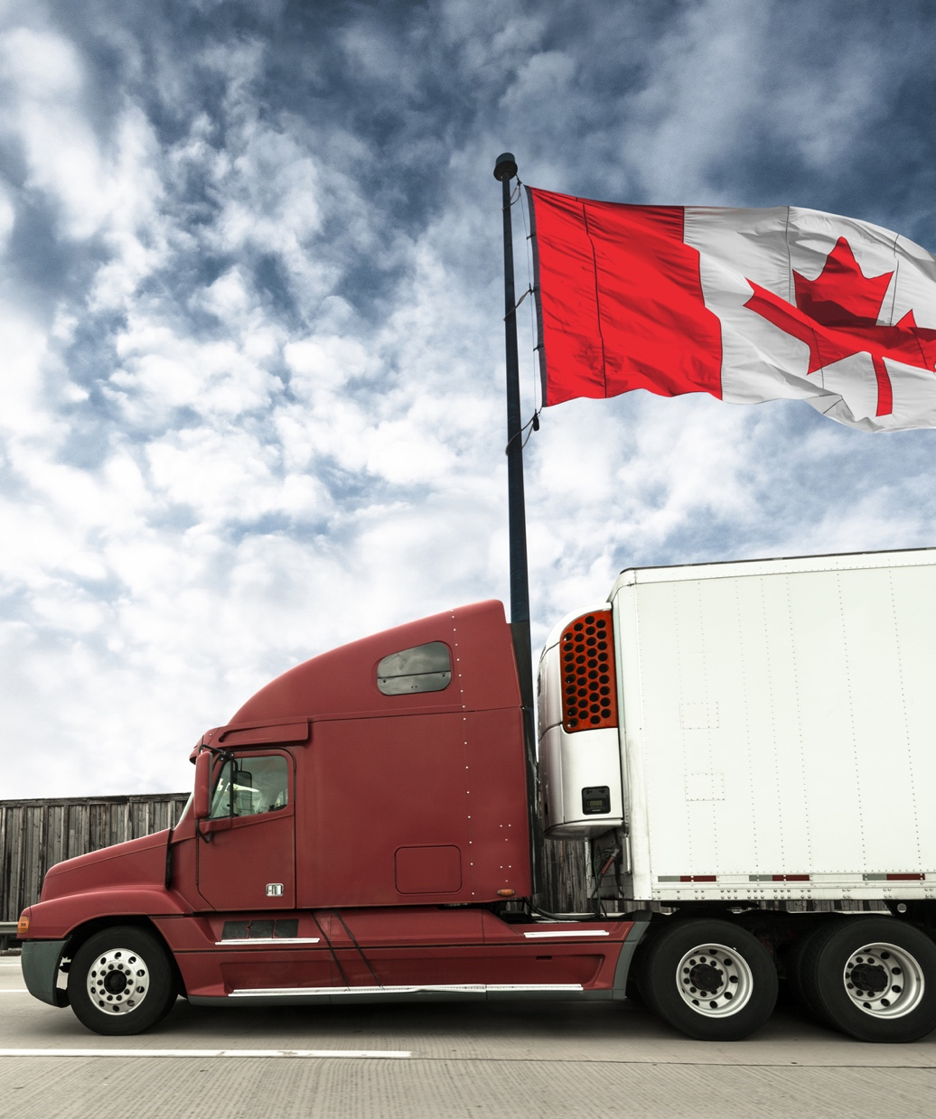
Presentations
Transport Canada:
Update on TC’s
ERG- related work
Notes:
Fady Al Zarka (Transport Canada) presented an update on TC’s current ERG-related work. TC is conducting a review of the LNG information in the ERG, including a gap analysis on what information is available academically and whether the ERG information is sufficient regarding LNG during transport. TC is also closing off a stakeholder survey on user satisfaction regarding the ERG. More information on this stakeholder survey and the ERG LRG review will be available in the next Roundtable meeting.

Slide 9
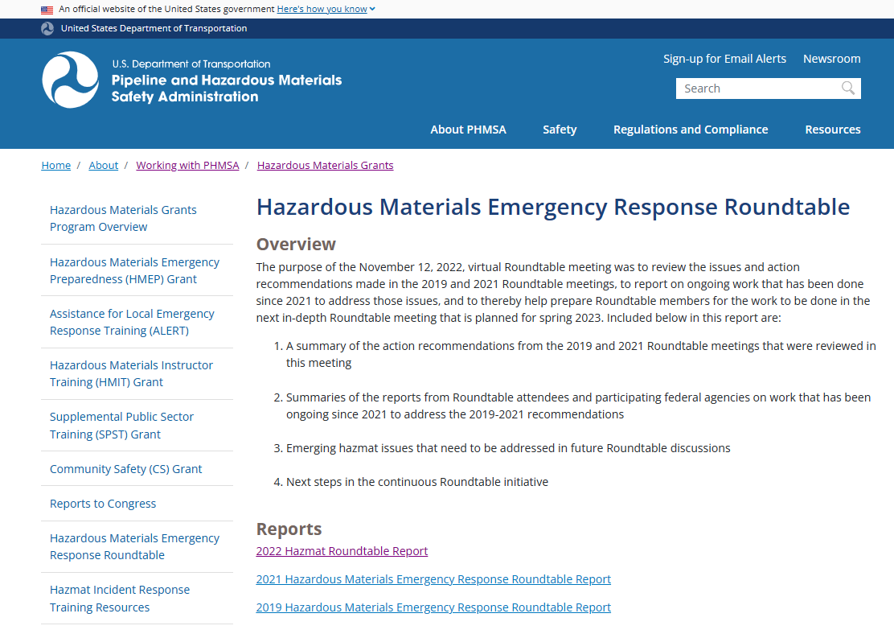
Roundtable Report Landing Page
https://www.phmsa.dot.gov/grants/hazmat/hazardous-materials-emergency-response-roundtable

Slide 10
2023 Roundtable Meeting Information
Date: Tuesday & Wednesday, May 9 – 10, 2023
Onsite: National Fire Academy, Emmitsburg, MD
Virtual: Link will be provided one week prior to session.

Slide 11



Questions • Comments
Eddie Murphy
Email: Eddie.Murphy@DOT.gov
Office: 202-366-7043
Cell: 202-734-9122

